Slide 1
Chapter 4: Threads & Concurrency

Slide 2
Outline
Overview
Multicore Programming
Multithreading Models
Thread Libraries
Implicit Threading
Threading Issues
Operating System Examples

Slide 3
Objectives
Identify the basic components of a thread, and contrast threads and processes
Describe the benefits and challenges of designng multithreaded applications
Illustrate different approaches to implicit threading including thread pools, fork-join, and Grand Central Dispatch
Describe how the Windows and Linux operating systems represent threads
Designing multithreaded applications using the Pthreads, Java, and Windows threading APIs

Slide 4
Motivation for Threads
Most modern applications are multithreaded
Threads run within application
Multiple tasks with the application can be implemented by separate threads
Update display
Fetch data
Spell checking
Answer a network request
Can simplify code, increase efficiency
Kernels are generally multithreaded
Issues with Processes:
Process creation is heavy-weight while thread creation is light-weight. The fork( ) system call is expensive – New PCB creation, new memory image (Address space) etc …
IPC is required to pass information between a parent and its child processes. Different techniques like FIFOs, Pipes, and sockets etc are different channels used for IPC.

Slide 5
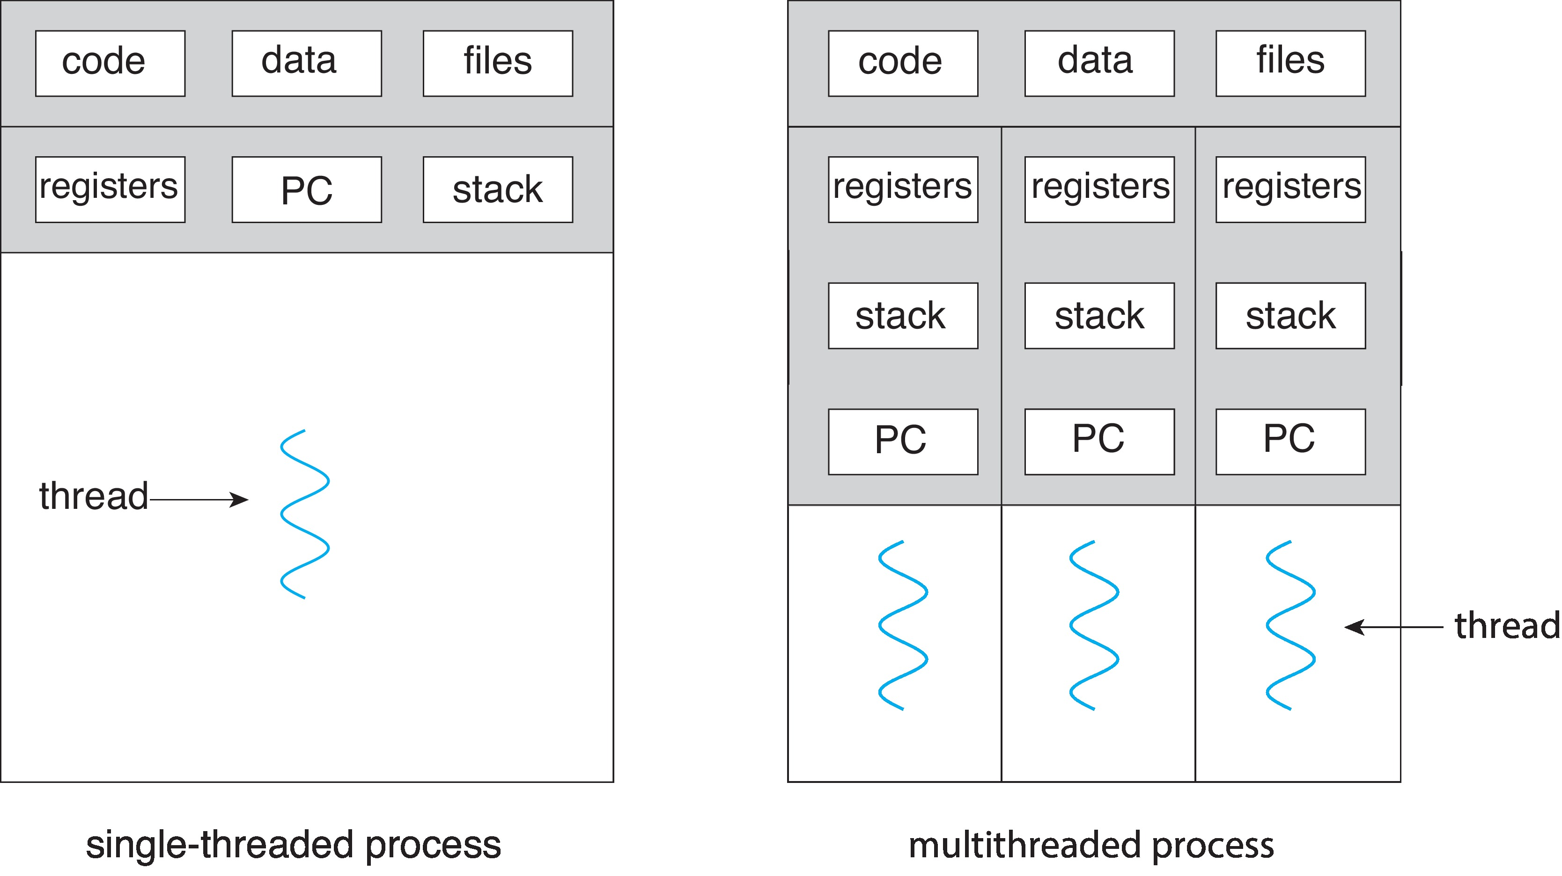
Single and Multithreaded Processes

Slide 6
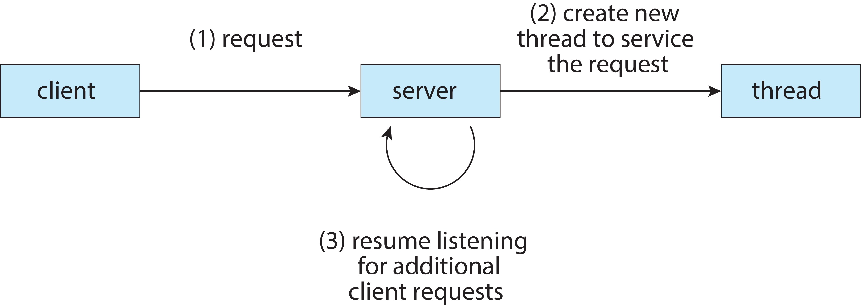
Multithreaded Server Architecture

Slide 7
Benefits
Responsiveness – may allow continued execution if part of process is blocked, especially important for user interfaces : e.g., web client running multiple things for end users
Resource Sharing – threads share resources of process (Code, Data, Memory, Kernel Data Structure such as PCB), easier than shared memory or message passing
Economy – cheaper than process creation, thread switching lower overhead than context switching of PCBs
Scalability – process can take advantage of multicore architectures. Single threaded process can only run on one CPU, no matter how many CPUs are available.

Slide 8
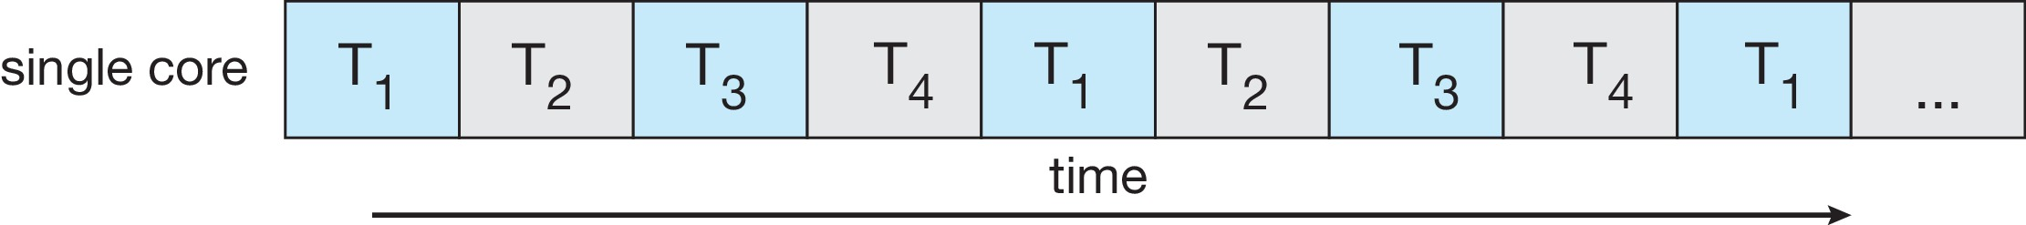
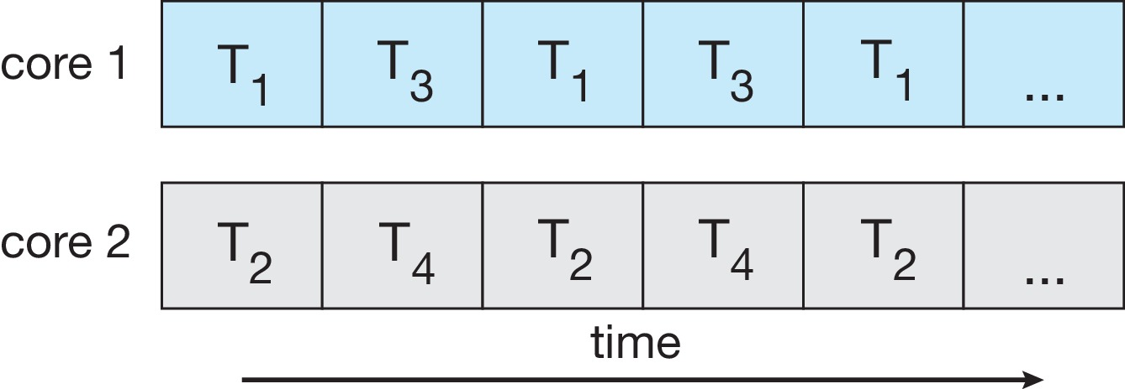
Concurrency vs. Parallelism
Concurrent execution on single-core system:
Parallelism on a multi-core system:

Slide 9
Multicore Programming
Multicore or multiprocessor systems puts pressure on programmers, challenges include:
Dividing activities – separate concurrent tasks
Balance – task perform equal work
Data splitting – Data accessed/manipulated must be divided
Data dependency – Reducing too much data dependencies
Testing and debugging – many execution paths are possible in code, testing/debugging such concurrent programs is inherently difficult than single-threaded applications
Parallelism implies a system can perform more than one task simultaneously
Concurrency supports more than one task making progress
Single processor / core, scheduler providing concurrency

Slide 10
Multicore Programming
Types of parallelism
Data parallelism – distributes subsets of the same data across multiple cores, same operation on each
Task parallelism – distributing threads across cores, each thread performing unique operation

Slide 11
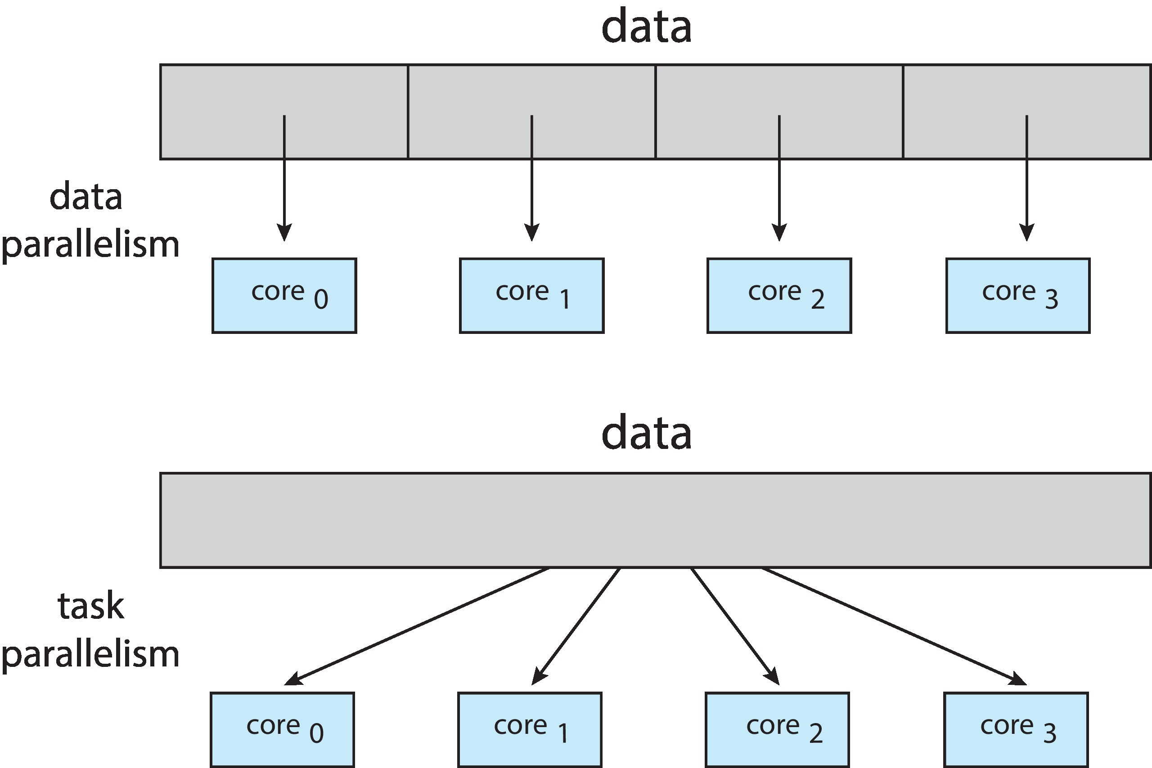
Data and Task Parallelism

Slide 12
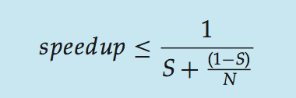
Amdahl’s Law
Identifies performance gains from adding additional cores to an application that has both serial and parallel components
S is serial portion
N processing cores
That is, if application is 75% parallel / 25% serial, moving from 1 to 2 cores results in speedup of 1.6 times
As N approaches infinity, speedup approaches 1 / S
Serial portion of an application has disproportionate effect on performance gained by adding additional cores
But does the law take into account contemporary multicore systems?

Slide 13
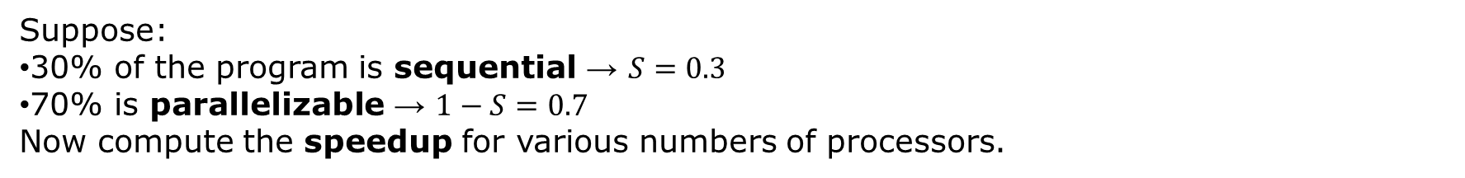

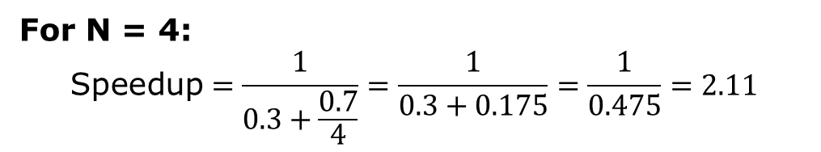
S = fraction of execution time that must be performed serially (sequentially)
(1−S) = fraction that can be parallelized
N = number of processing units (CPUs or cores)
Suppose:
30% of the program is sequential → $S=0.3$
70% is parallelizable → $1−S=0.7$
Now compute the speedup for various numbers of processors.
For N = 4:
$$\text{Speedup}=\frac{1}{0.3+\frac{0.7}{4}}=\frac{1}{0.3+0.175}=\frac{1}{0.475}=2.11$$
When you run the program on 4 processors, it will execute 2.11 times faster than when it runs on 1 processor.
If the program took 10 seconds to run on 1 CPU, it would take approximately:
$$\frac{10}{2.11}≈4.74 \text{seconds} \text{on} \text{4 }\text{CPUs}\text{.}$$

Slide 14
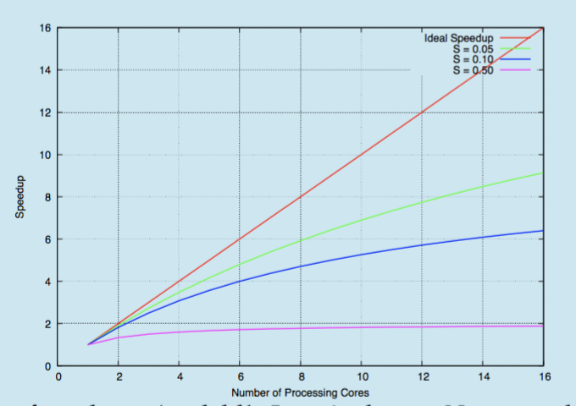
Amdahl’s Law

Slide 15
User Threads and Kernel Threads
User threads - management done by user-level threads library
Three primary thread libraries:
POSIX Pthreads
Windows threads
Java threads
Kernel threads - Supported by the Kernel
Examples – virtually all general-purpose operating systems, including:
Windows
Linux
Mac OS X
iOS
Android

Slide 16
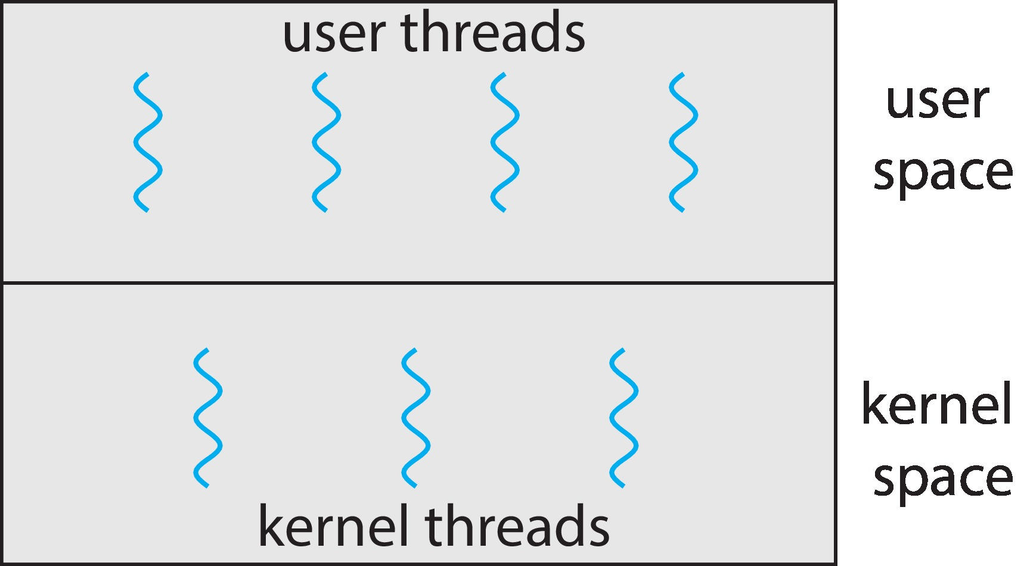
User and Kernel Threads

Slide 17
Multithreading Models
Many-to-One
One-to-One
Many-to-Many

Slide 18
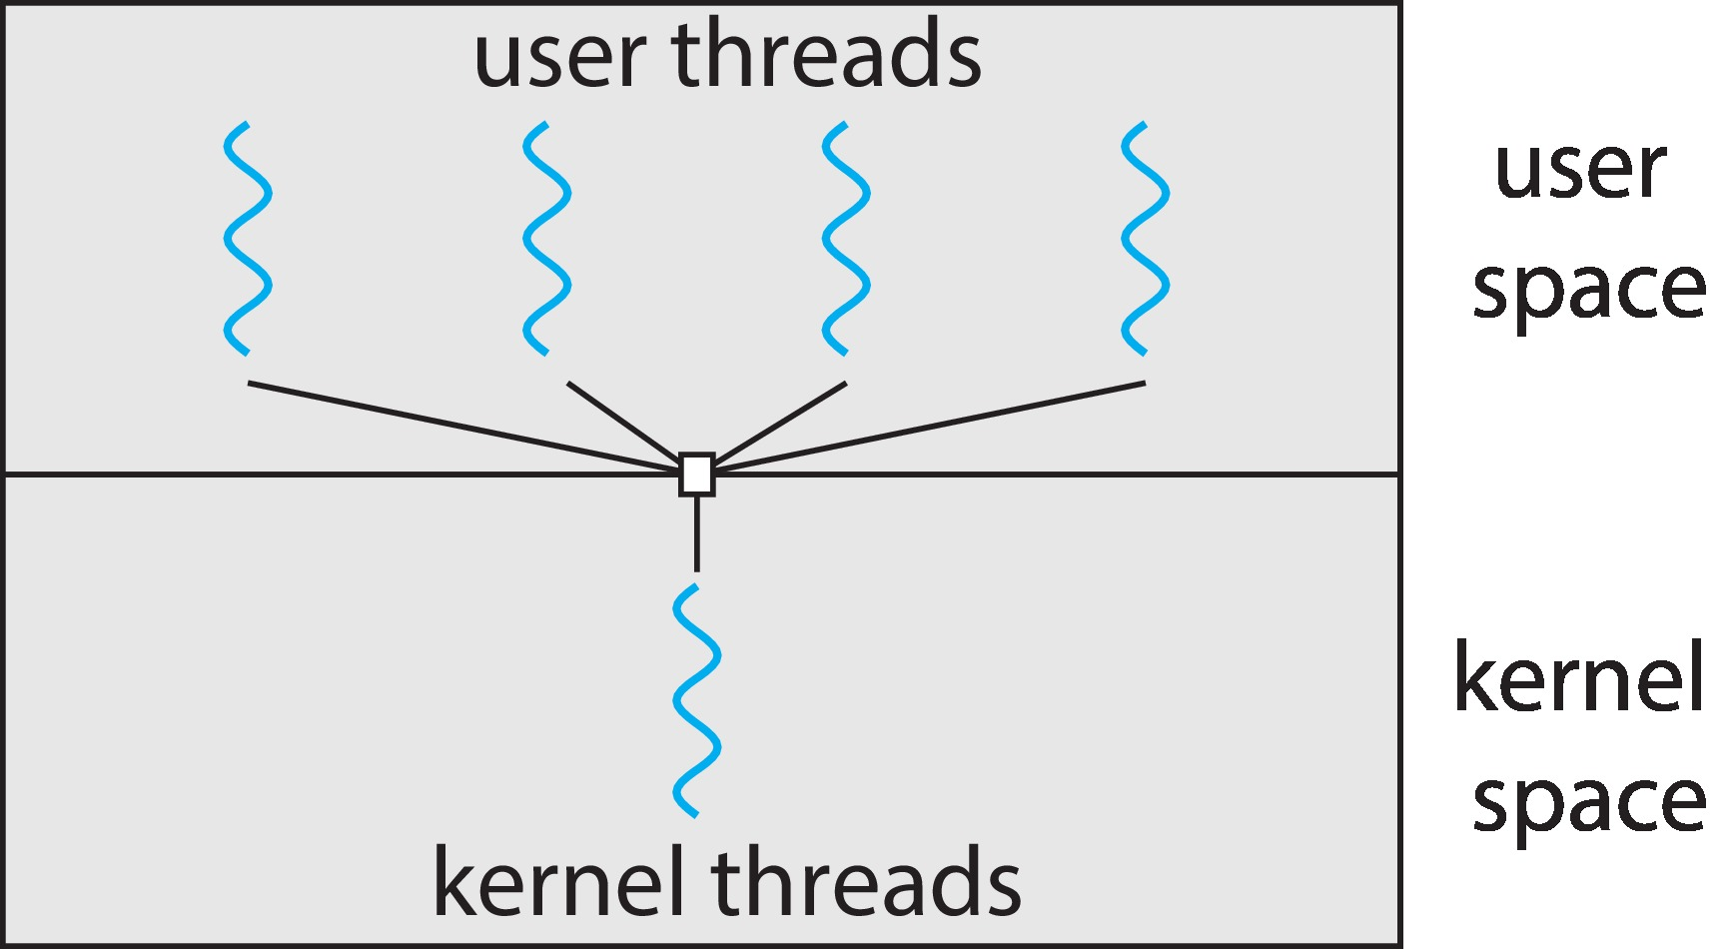
Many-to-One
Many user-level threads mapped to single kernel thread
One thread blocking causes all to block
Multiple threads may not run in parallel on multicore system because only one may be in kernel at a time
Few systems currently use this model
Examples:
Solaris Green Threads
GNU Portable Threads

Slide 19
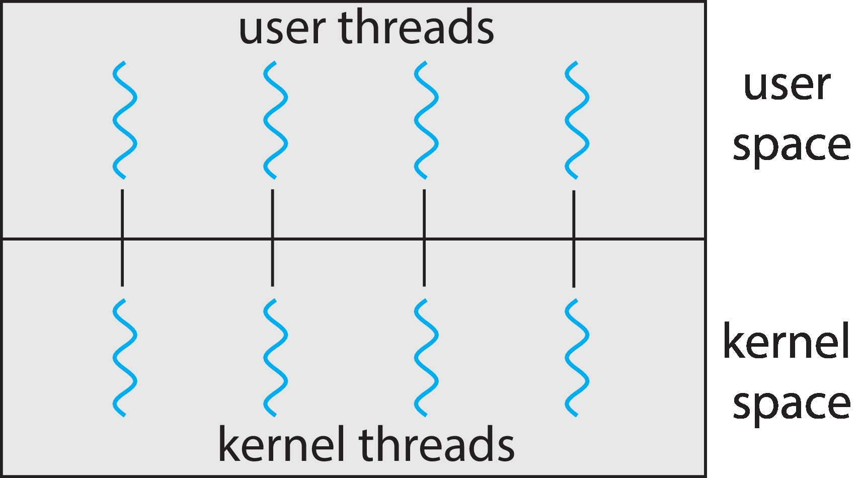
One-to-One
Each user-level thread maps to kernel thread
Creating a user-level thread creates a kernel thread
More concurrency than many-to-one
Number of threads per process sometimes restricted due to overhead
Examples
Windows
Linux

Slide 20
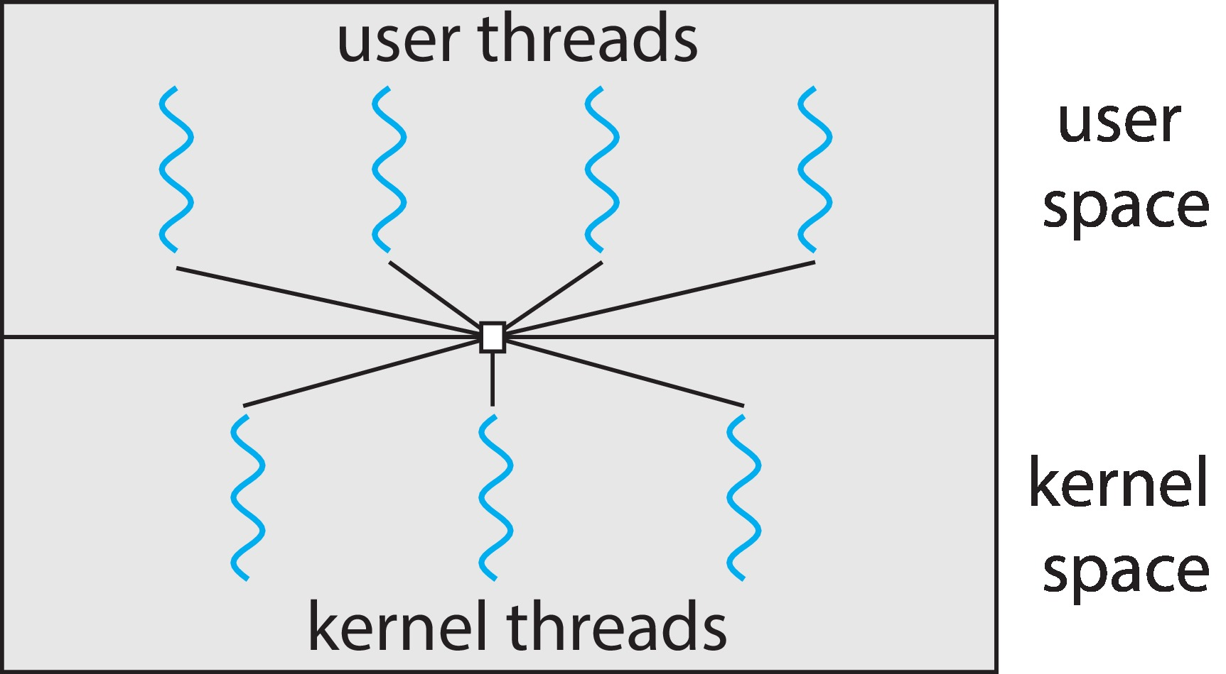
Many-to-Many Model
Allows many user level threads to be mapped to many kernel threads
Allows the operating system to create a sufficient number of kernel threads
Windows with the ThreadFiber package
Otherwise not very common

Slide 21
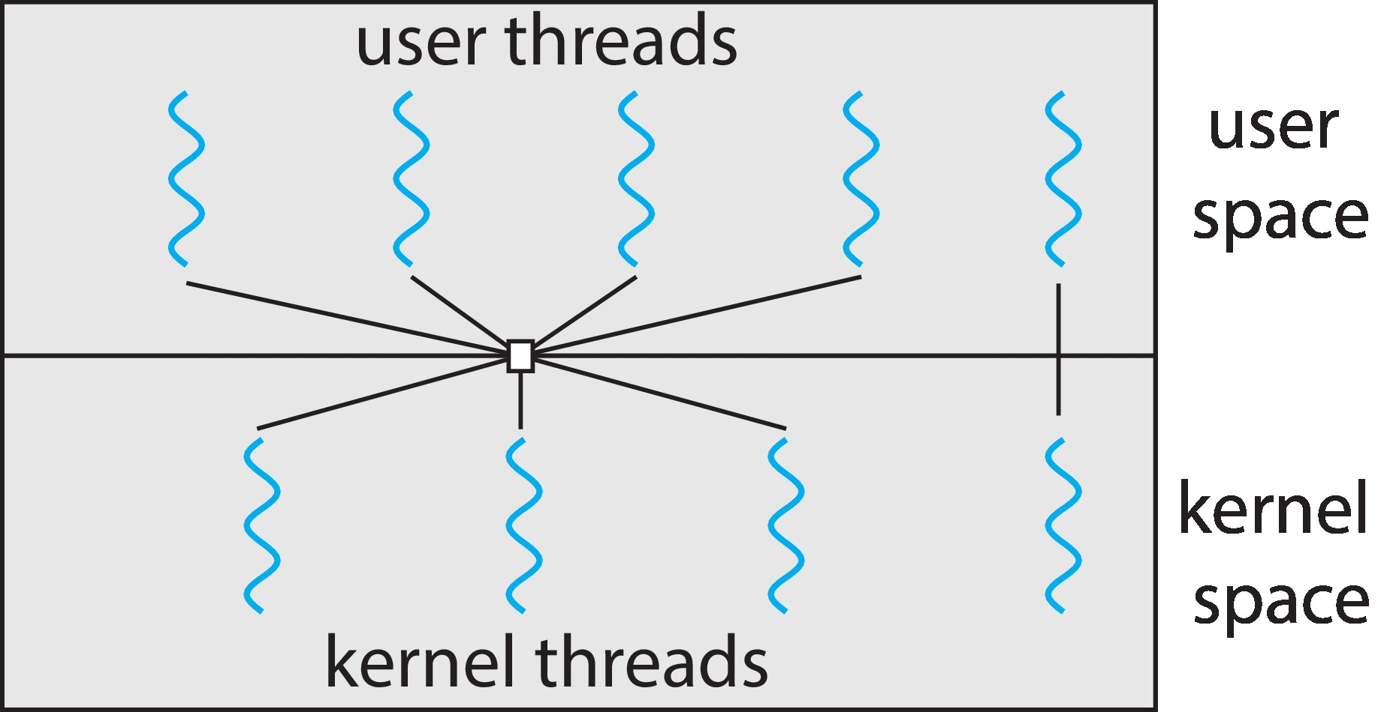
Two-level Model
Similar to M:M, except that it allows a user thread to be bound to kernel thread

Slide 22
Thread Libraries
Thread library provides programmer with API for creating and managing threads
Two primary ways of implementing
Library entirely in user space
Kernel-level library supported by the OS

Slide 23
Pthreads
May be provided either as user-level or kernel-level
A POSIX standard (IEEE 1003.1c) API for thread creation and synchronization
Specification, not implementation
API specifies behavior of the thread library, implementation is up to development of the library
Common in UNIX operating systems (Linux & Mac OS X)

Slide 24
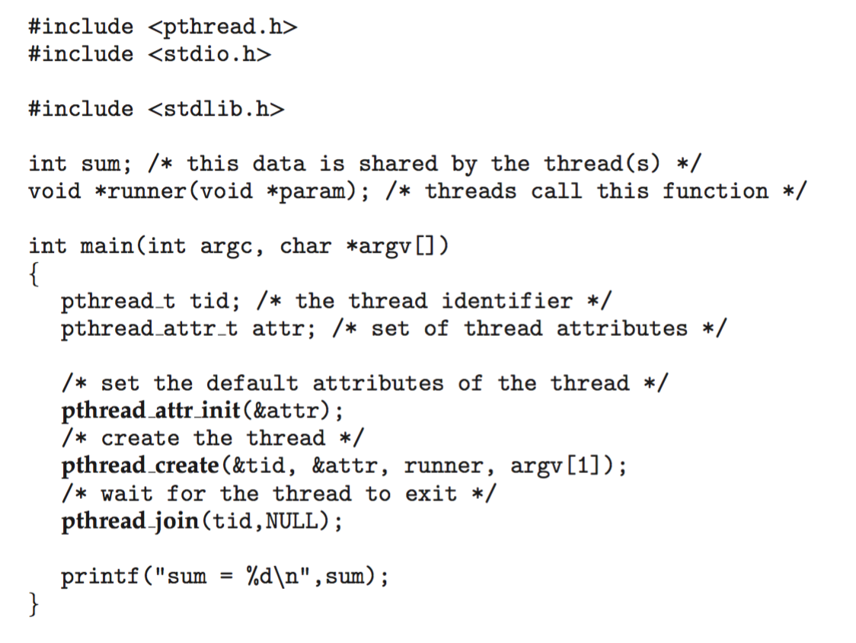
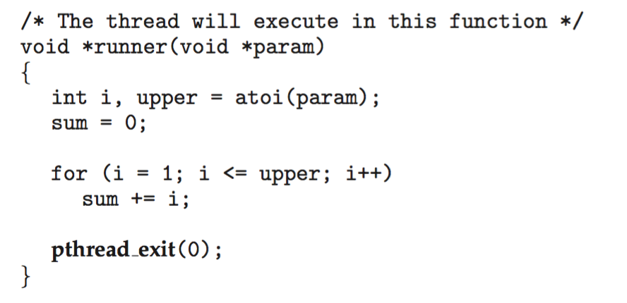
Pthreads Example

Slide 25
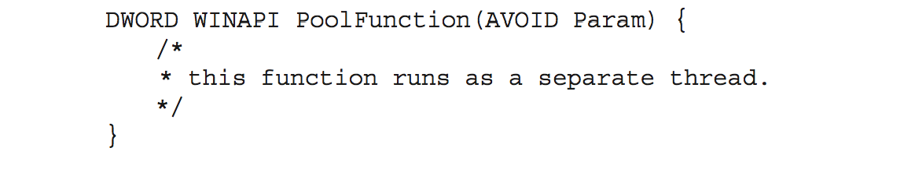
Thread Pools
Create a number of threads in a pool where they await work
Advantages:
Usually slightly faster to service a request with an existing thread than create a new thread
Allows the number of threads in the application(s) to be bound to the size of the pool
Separating task to be performed from mechanics of creating task allows different strategies for running task
i.e,Tasks could be scheduled to run periodically
Windows API supports thread pools:

Slide 26
Threading Issues
Semantics of fork() and exec() system calls
Signal handling
Synchronous and asynchronous
Thread cancellation of target thread
Asynchronous or deferred
Thread-local storage
Scheduler Activations

Slide 27
Semantics of fork() and exec()
Does fork()duplicate only the calling thread or all threads?
Some UNIXes have two versions of fork
exec() usually works as normal – replace the running process including all threads

Slide 28
Signal Handling
Signals are used in UNIX systems to notify a process that a particular event has occurred.
A signal handler is used to process signals
Signal is generated by particular event
Signal is delivered to a process
Signal is handled by one of two signal handlers:
default
user-defined
Every signal has default handler that kernel runs when handling signal
User-defined signal handler can override default
For single-threaded, signal delivered to process

Slide 29
Signal Handling (Cont.)
Where should a signal be delivered for multi-threaded?
Deliver the signal to the thread to which the signal applies
Deliver the signal to every thread in the process
Deliver the signal to certain threads in the process
Assign a specific thread to receive all signals for the process

Slide 30
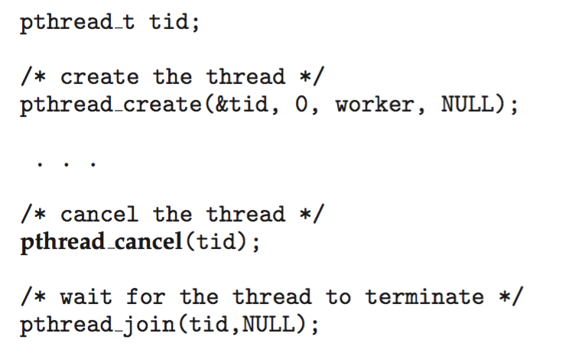
Thread Cancellation
Terminating a thread before it has finished
Thread to be canceled is target thread
Two general approaches:
Asynchronous cancellation terminates the target thread immediately
Deferred cancellation allows the target thread to periodically check if it should be cancelled
Pthread code to create and cancel a thread:

Slide 31
Thread-Local Storage
Thread-local storage (TLS) allows each thread to have its own copy of data
Useful when you do not have control over the thread creation process (i.e., when using a thread pool)
Different from local variables
Local variables visible only during single function invocation
TLS visible across function invocations
Similar to static data
TLS is unique to each thread

Slide 32
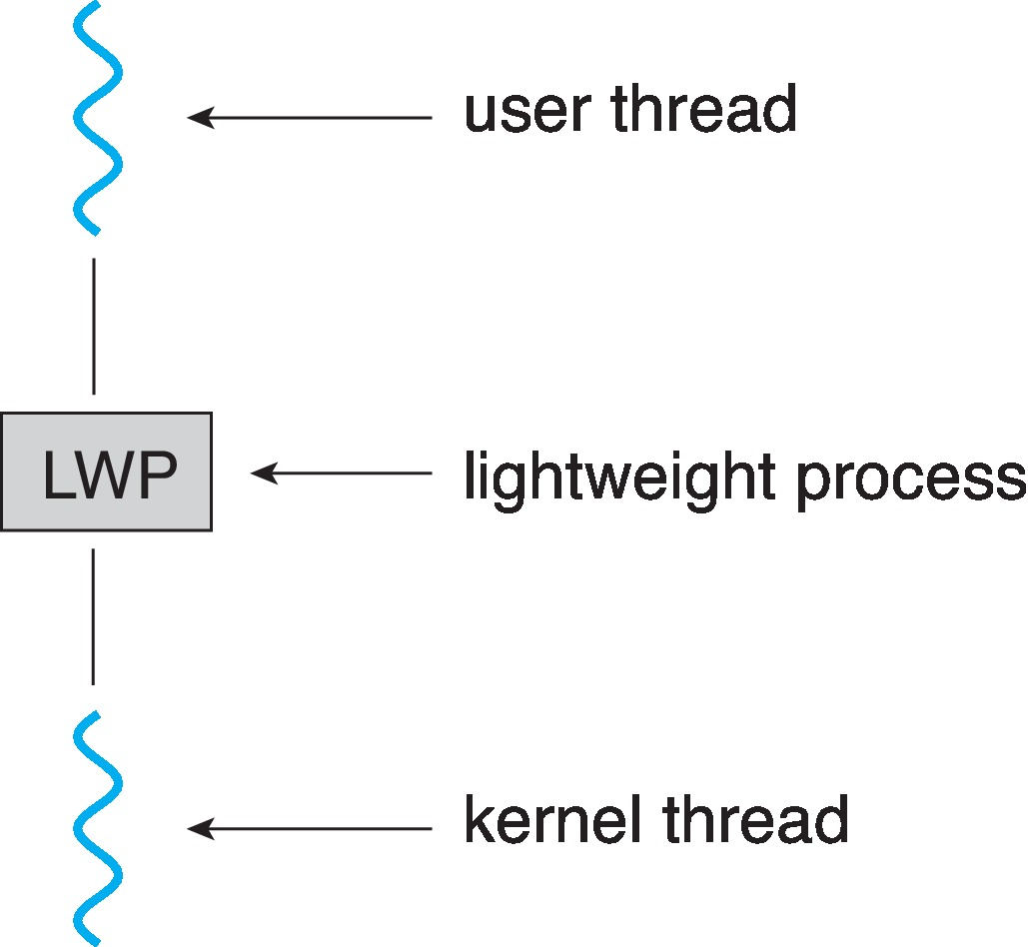
Scheduler Activations
Both M:M and Two-level models require communication to maintain the appropriate number of kernel threads allocated to the application
Typically use an intermediate data structure between user and kernel threads – lightweight process (LWP)
Appears to be a virtual processor on which process can schedule user thread to run
Each LWP attached to kernel thread
How many LWPs to create?
Scheduler activations provide upcalls - a communication mechanism from the kernel to the upcall handler in the thread library
This communication allows an application to maintain the correct number kernel threads

Slide 33
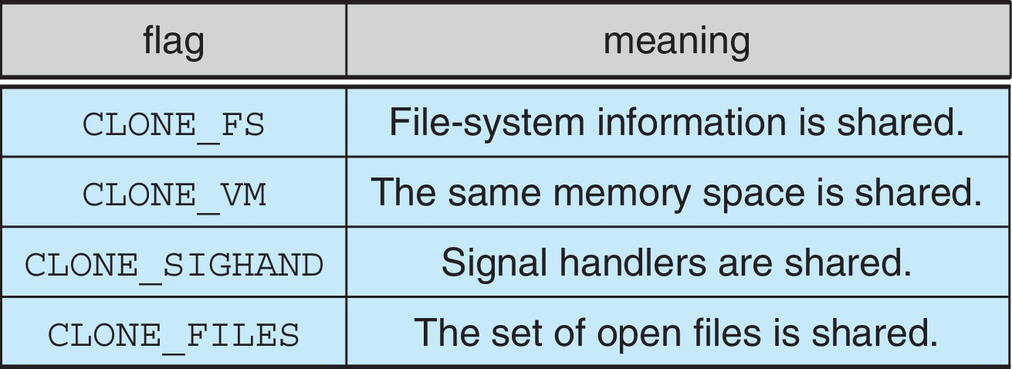
Linux Threads
Linux refers to them as tasks rather than threads
Thread creation is done through clone() system call
clone() allows a child task to share the address space of the parent task (process)
Flags control behavior
struct task_struct points to process data structures (shared or unique)

Slide 34
End of Chapter 4

